Slide 1
表 面 物 理 学
江 颖
量子材料科学中心

Slide 2
原子力显微镜
（Atomic Force Microscopy）
静态接触模式
动态非接触模式
信噪比分析
应用

Slide 3
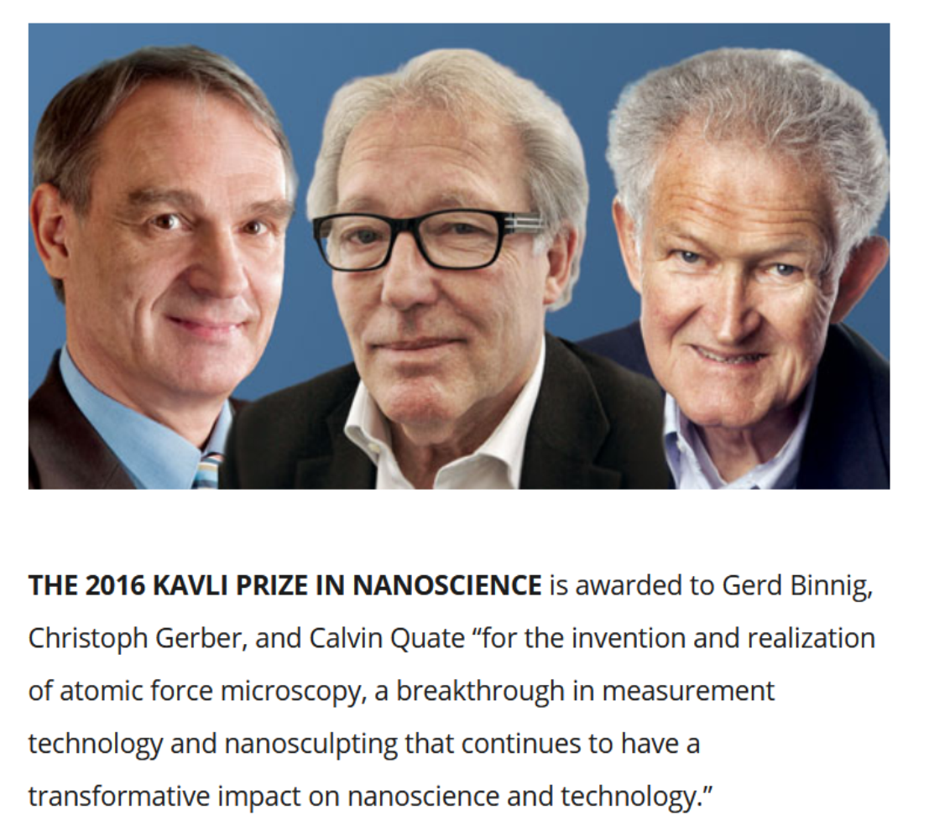
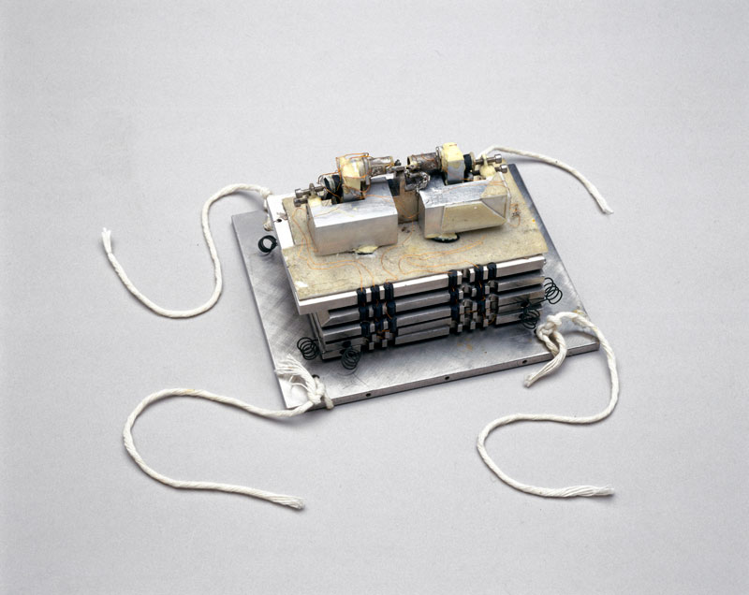
第一台原子力显微镜
The first atomic force microscope, 1985. Made by Calvin Quate and Gerd Binnig of Stanford University, and Christoph Gerber of IBM Research.

Slide 4
AFM traces on Al₂O₃
A lateral resolution of 30 Å and a vertical resolution of less than 1 Å
‎Cited by 20358 (Google Scholar)

Slide 5
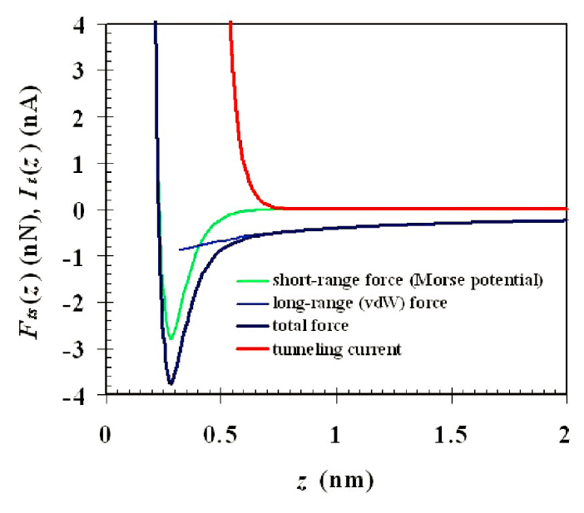
原子力显微镜的挑战性
Four challenges of AFM:
The jump-to-contact problem
Nonmonotonic force with distance
Background of long-range forces
Measurement of nN-pN forces
相比STM，AFM更难获得原子级分辨
Giessibl, Rev. Mod. Phys. 75, 949 (2003)

Slide 6
原子力显微镜
Courtesy of Zhihai Cheng@Renmin University

Slide 7
静态接触模式
Courtesy of Hiroshi Onishi@Kobe University

Slide 8
接触模式的分辨率
原子分辨率需要单原子针尖

Slide 9
静态接触模式的困境
如何在避免jump-to-contact的同时保证高的灵敏度？

Slide 10
动态非接触模式
利用大的振幅和小的弹性系数：A=34 nm, k = 17 N/m

Slide 11


调频和调幅模式
$$Q=\frac{2πE}{∆E_{cycle}}$$
$E=kA^{2}$/2

Slide 12
振幅调制模式
Courtesy of Zhihai Cheng@Renmin University

Slide 13
振幅调制模式
优点：
It is relatively simple to measure the amplitude at the operational frequency of the cantilever—a lock-in technique allows for excellent precision.
The tip-sample interaction upon reducing the distance reduces the amplitude in a more or less monotonic fashion.
缺点：
Both dissipative and non-dissipative parts of the interaction force change the resulting amplitude, and a separation of those two force parts is not straightforward.
With Q factors reaching 100 000 in vacuum, the AM mode is very slow.

Slide 14
频率调制模式

Slide 15
短程力和长程力的贡献随振幅变化
F_{0lr} = 3F_{0sr} and λ_{lr}= 30λ_{sr}
Giessibl, Rev. Sci. Instrum. 90, 011101 (2019)

Slide 16
各种噪音的影响
热噪音：
增大振幅 A
增大共振频率 f₀
增大品质因子 Q
减小弹性系数 k
探测器噪音：
振荡器噪音：
频率漂移噪音：
Giessibl, Rev. Sci. Instrum. 90, 011101 (2019)

Slide 17
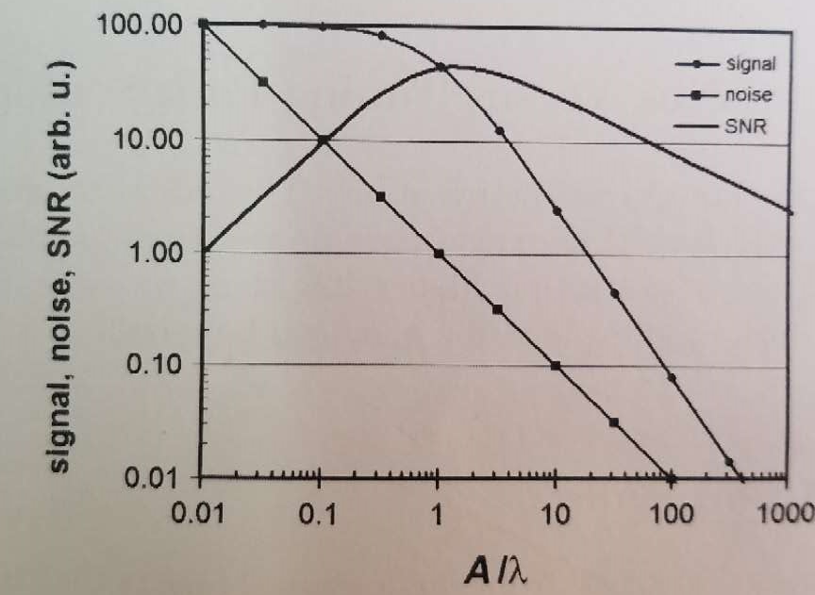
信噪比与振幅的关系
最佳振幅：A_{opt} =1.545 λ
λ_{lr}= 20 pm, A_{opt}=30 pm
λ_{lr}= 50 pm, A_{opt}=75 pm
一般来说，原子分辨成像需要的最佳振幅 A~100 pm
Morita, Wiesendanger, Meyer, Noncontact Atomic Force Microscopy, Springer, 2009

Slide 18
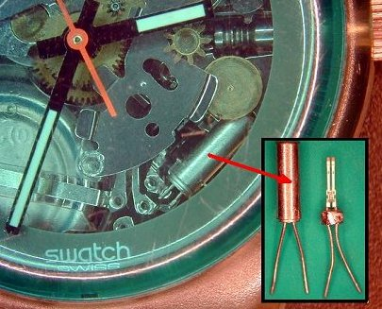
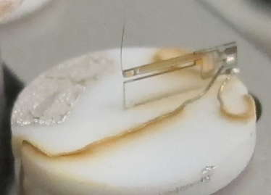
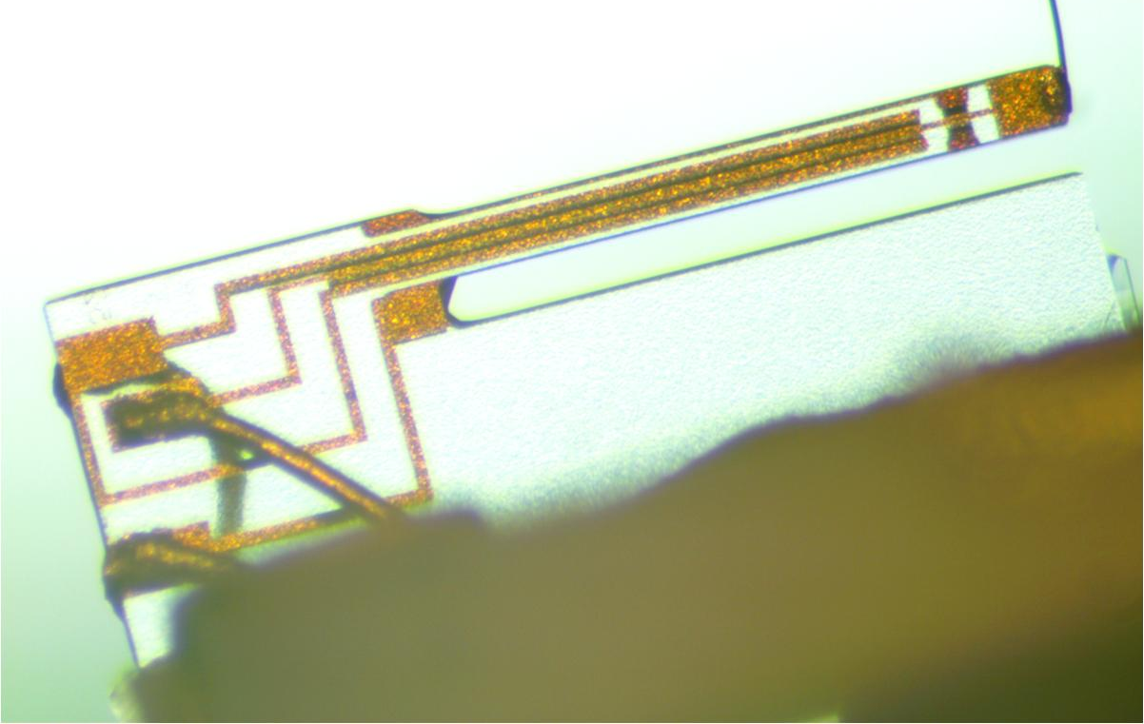
qPlus-type sensor
qPlus sensor
Tip
STM
AFM
f₀ = 32768 Hz = 2¹⁵ Hz
Stiffness k | 1800 N/m
Eigenfrequency f₀ | ~ 32 kHz
Quality factor Q | >50000
Amplitude | ~20 pm
Minimum current | Minimum force
< 100 fA | < 10 pN
Scanning Tunneling Microscope + Atomic Force Microscope

Slide 19
各种石英传感器
Standard qPlus sensor
Needle sensor (Length extensional
Resonator)
f₀~ 1MHz
Biaxial qPlus sensor
Vertical + lateral force
Giessibl, Rev. Sci. Instrum. 90, 011101 (2019)

Slide 20
磁场中的qPlus sensor
Q=20000 at B = 8 T@ NIST
The eddy current damping may reduce Q values at high magnetic fields.
Giessibl, Rev. Sci. Instrum. 90, 011101 (2019)

Slide 21
测量移动单个原子的力
Measuring the force to move a single Co atom on a Pt(111) surface
Ternes et al., Science 319, 1066 (2008)

Slide 22
分辨原子团簇中的原子
STM
AFM
Model
Fe dimers, trimers, and tetramers on Cu(111)
Emmrich et al., Science 348, 308 (2015)

Slide 23
分辨分子中的化学键
STM
STM
AFM
Gross et al., Science 2009

Slide 24
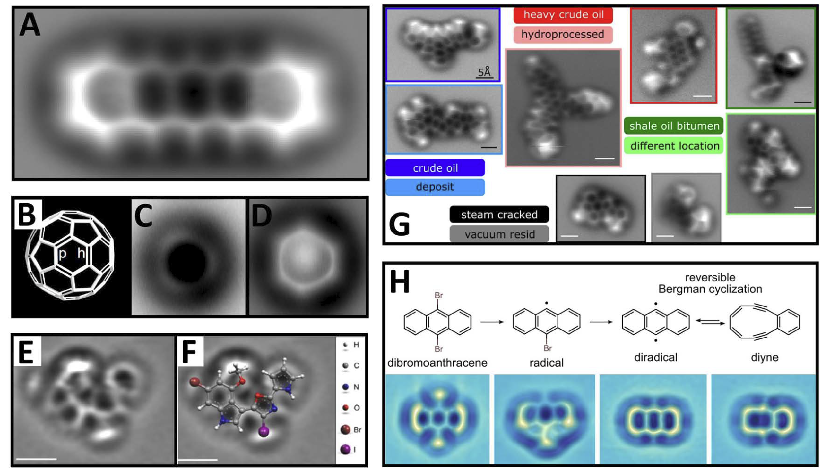
分辨分子中的化学键
Meyer and Gross et al. @ IBM Zurich
Science 325, 1110 (2009).
Nat. Chem. 8, 220 (2016).
Angew. Chem., Int. Ed. 51, 12238 (2012)
Science 337, 1326 (2012).
Energy Fuels 31, 6856 (2017).

Slide 25
分子间相互作用
STM and AFM measurements of 8-hydroxyquinoline (8-hq) assembled clusters on Cu(111)
直接 “看见”分子间的氢键！
氢键的共价性？
Zhang et al., Science 342, 611 (2013).

Slide 26
磁交换相互作用
Exchange interaction on NiO surface measured without an external magnetic field and a CoSm tip attached to a qPlus sensor.
Pielmeier and Giessibl, Phys. Rev. B 110, 266101 (2013)

Slide 27
氧化物表面
Overview of nc-AFM results on oxides from Diebold in Vienna, Austria
Stevin et al., Chem. Soc. Rev. 46, 1772 (2017)
Notes:
Overview of nc-AFM results on oxides obtained in the group of Diebold in Vienna, Austria. Top row [(a)–(c)]: Rutile TiO2 with well-defined surface oxygen vacancies
(VO) is a model system for defect related surface chemistry; see atomic model in (a). Traditionally, empty-state STM images are used, where the VOs appear as extra
bright spots between rows of five-fold coordinated Ti5c atoms, as in panel (b). With non-contact AFM in the repulsive mode [(c) on the same area as in (b)], the two-fold
O2c atoms are apparent, and VOs are clearly identified as missing atoms; see Refs. 198, 218, and 219. Middle row [(d)–(f)]: AFM is also an ideal tool to investigate the
oxygen surface chemistry on anatase TiO2(101).220 Upon exposure to molecular O2 at low temperatures, two species are apparent as spots with different contrast in
panel (d). In force-distance curves (e), these are identified as neutral and singly charged (O2)􀀀 species, respectively. By ramping the sample bias voltage VS, a neutral O2
can be converted into a charged (O2)􀀀 underneath the tip; see panel (f).

Slide 28
水/固界面

Slide 29
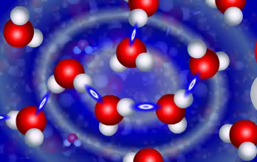
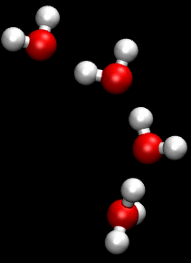
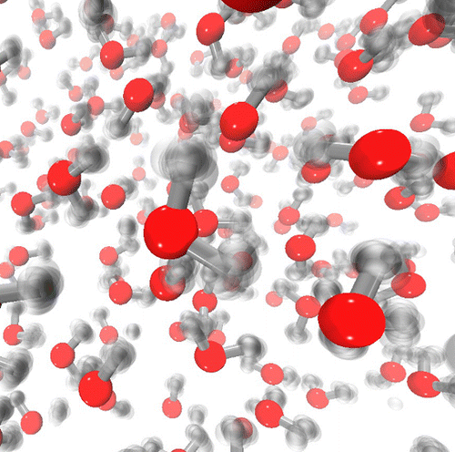
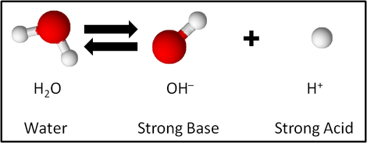
The role of hydrogen in water
H-bonding network
Proton transfer
Hydrogen
Nuclear quantum effects
Water dissociation
How to access the degree of freedom of hydrogen?

Slide 30
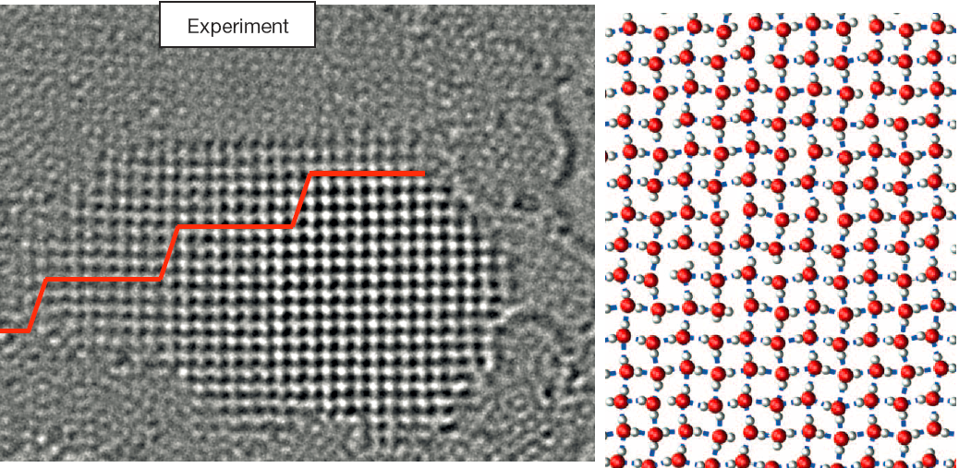
How difficult to see hydrogen atom
Spectroscopic methods: Neutron scattering, optical spectroscopy, NMR
Scanning tunneling microscopy
Transmission electron microscopy
Nature 519, 443 (2015)
Nature Materials 11, 667 (2012)
No internal structure of water resolved !

Slide 31
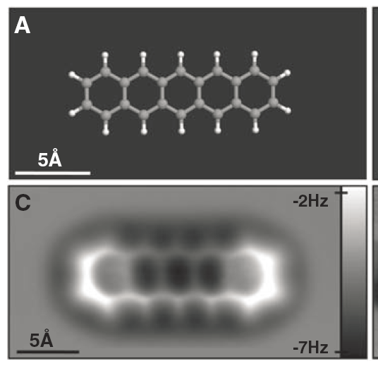
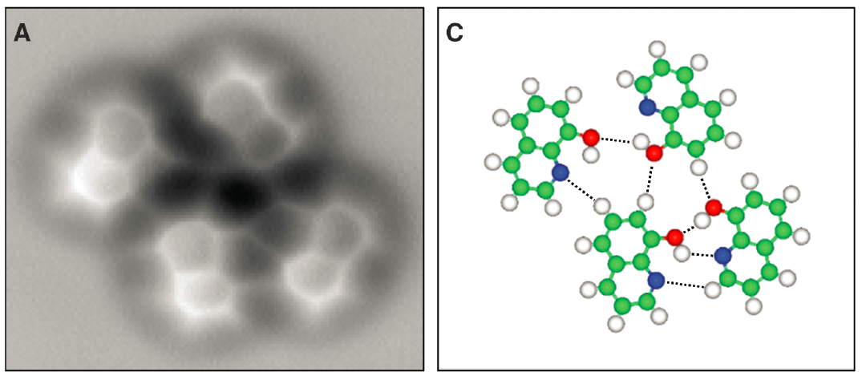
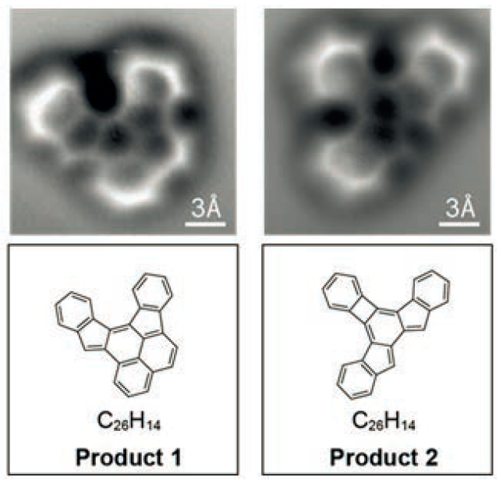
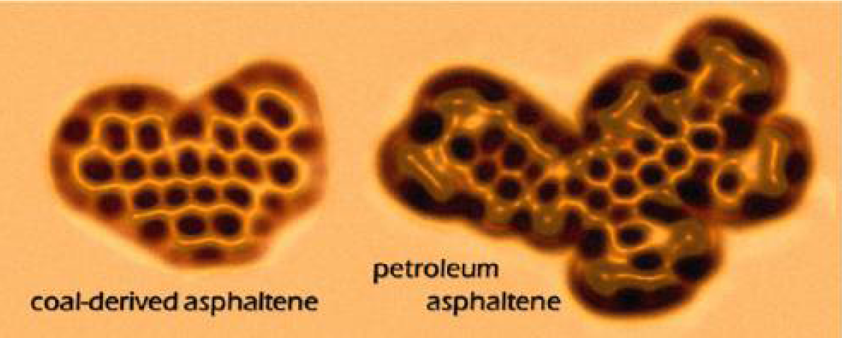
Organic molecules
Pentacene
8-hydroxyquinoline
Zhang et al., Science 2013
Gross et al., Science 2009
Schuler et al., JACS 2015
Chemical structures are directly visualized by short-range Pauli repulsion force
Oteyza et al., Science 2013

Slide 32
Water imaging by qPlus-AFM
Shiotari et al., Nat. Commun. 8, 14313 (2017)
Peng et al., Nat. Commun. 9, 122 (2018)
The H-bonding skeleton of water is clearly visible, but the directionality of the H bond is not resolved.
How to distinguish the H atoms?

Slide 33
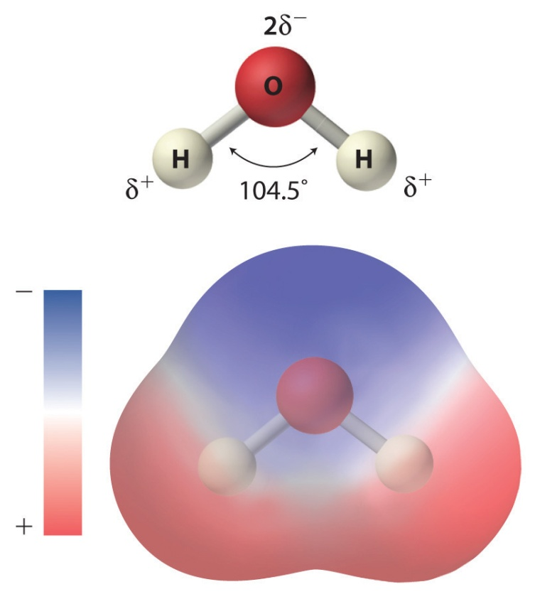
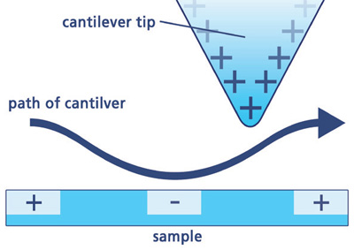
Electrostatic imaging by AFM
1Å
Charge distribution of water
Electrostatic force microscopy
Distinguish the positive H from the negative O by electrostatic force?

Slide 34
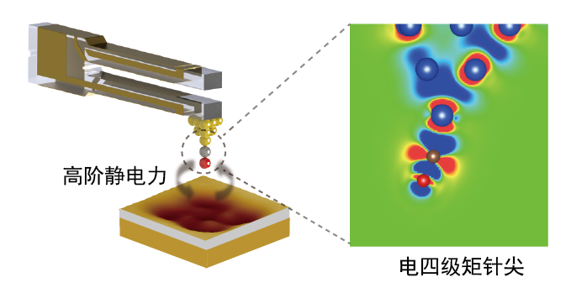
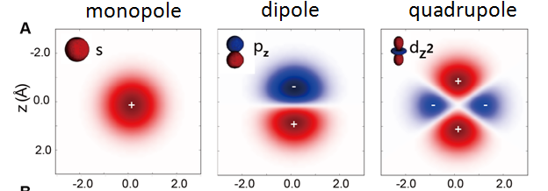
High-order electrostatic force
Metal tip
High-order electrostatic force
CO molecule
Quadrupole-like tip
1/r²
1/r³
1/r⁴
Peng et al. Nat. Commun. 9, 122 (2018)
Notes:
In order to understand these features, ourcollaboratorsProkop Hapala, Prof. Pavel Jelinek built a AFM model with L-J potential to simulate the interaction between the probe particle and the molecule. With this model，they have successfully reproduced the sharp lines at the chemical bond and between molecules. In our experiment, we have to add a special term----the electrostatic force between the Cl-tip and water molecules.

Slide 35
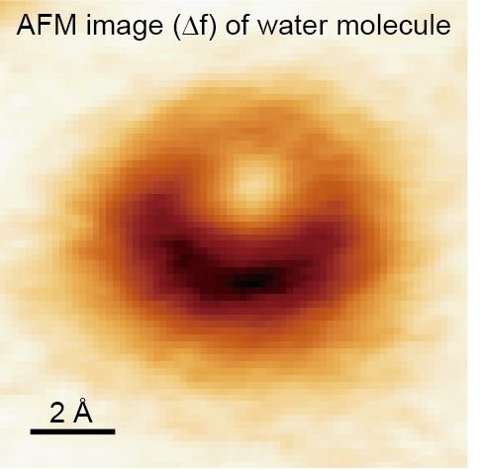
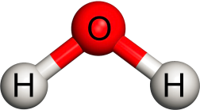
Water monomer
Charge distribution of water
Electrostatic force imaging

Slide 36
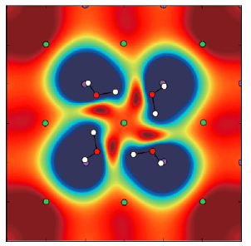
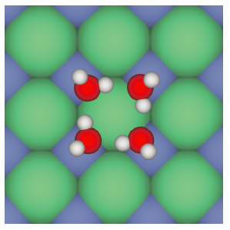
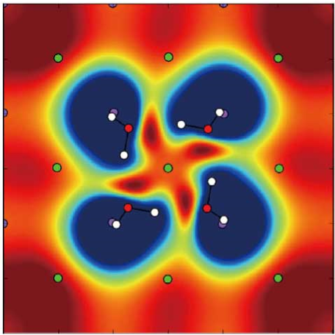
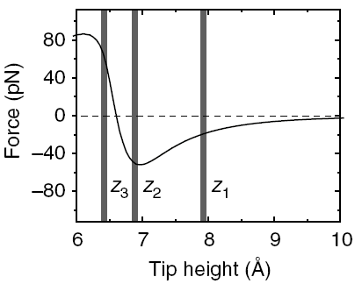
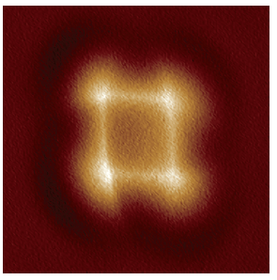
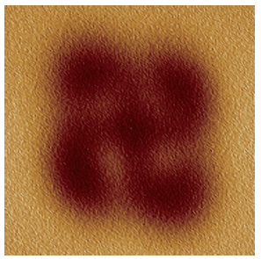
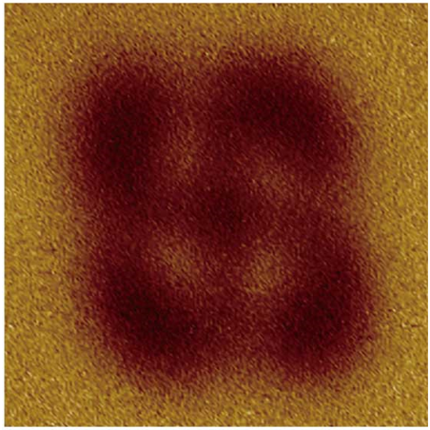
AFM imaging of water tetramer
Structural model
Electrostatic potential
AFM image@
small tip height
AFM image@
large tip height
@Jiang lab
H-sensitive and non-invasive probe
H-bonding skeleton
Directionality of the H bond
Peng et al. Nat. Commun. 9, 122 (2018)

Slide 37
Various water clusters
Dimer
Tetramer
Na⁺ hydrate

Slide 38
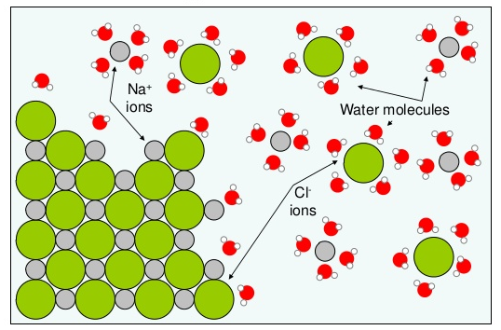

Ion hydrates
Highly dynamic
Multiple metastable states
Strong polarization effect
Delicate interplay between different interactions
Non-invasive detection at atomic scale

Slide 39

Preparation of Na⁺ hydrates
Peng et al., Nature 557, 701 (2018)

Slide 40
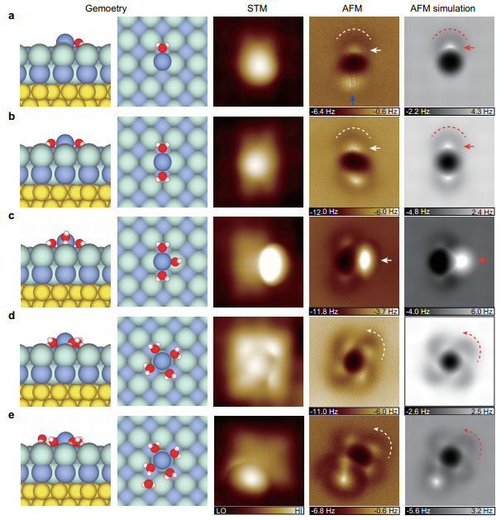
STM/AFM images of Na⁺ hydrates
Na⁺ • H₂O
Na⁺ • 2H₂O
Na⁺ • 3H₂O
Na⁺ • 4H₂O
Na⁺ • 5H₂O
Peng et al., Nature 557, 701 (2018)

Slide 41
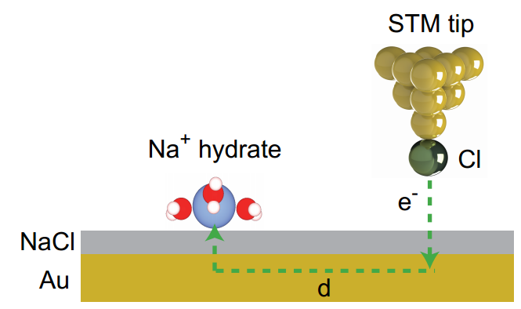
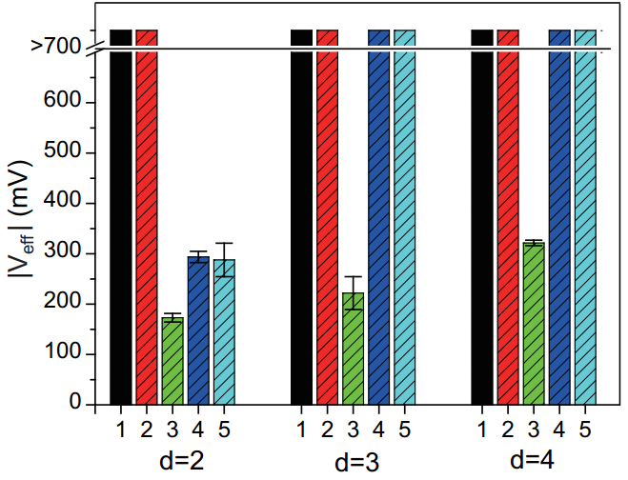
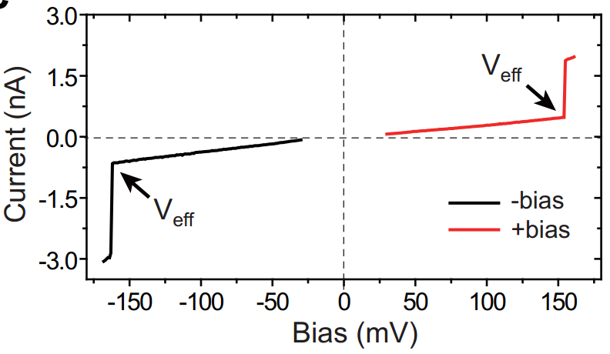
Tip-induced diffusion dynamics
Na⁺•3H₂O has exceptionally high mobility
Magic-number effect !
Peng et al., Nature 557, 701 (2018)

Slide 42
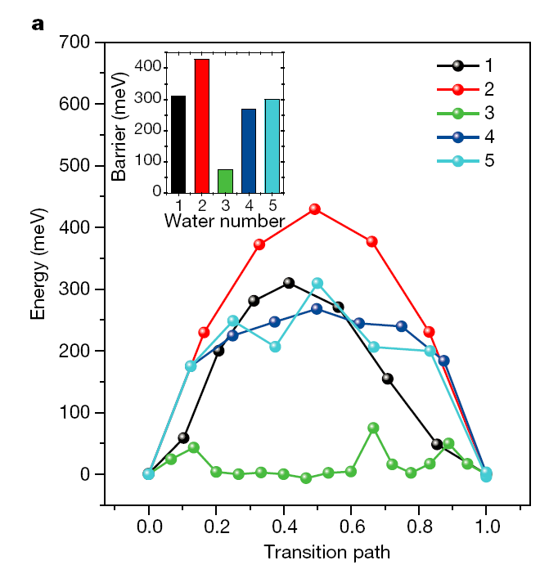
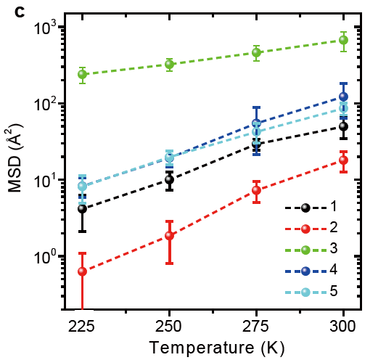
Diffusion of the Na⁺ hydrates
Diffusion barrier (DFT)
Diffusivity (MD)
Na⁺•3H₂O has exceptionally high mobility
Magic hydration-number effect !
Peng et al., Nature 557, 701 (2018)

Slide 43
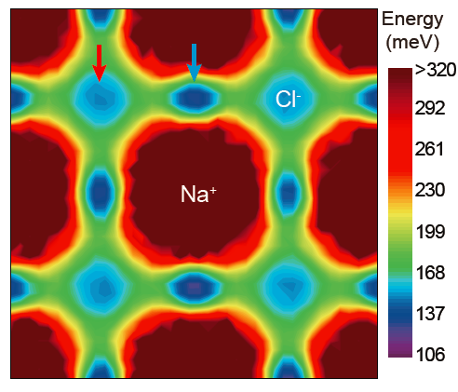
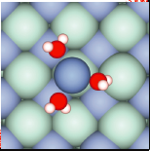
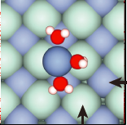
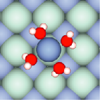
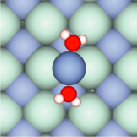
Free energy map of Na⁺ • 3H₂O
Top site
Bridge site
C₄
C₂
The magic number is dictated by the degree of symmetry match between the ion hydrates and the surface lattice.
Peng et al., Nature 557, 701 (2018)
Notes:
Na+3water最稳态之间很多亚稳态

Slide 44
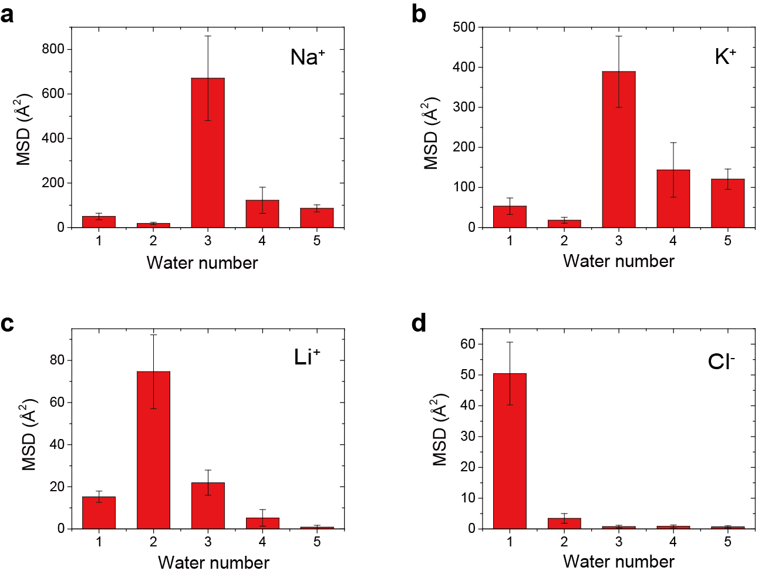
The magic hydration-number effect
of other salt ions

Slide 45
Two-dimensional ice

Slide 46
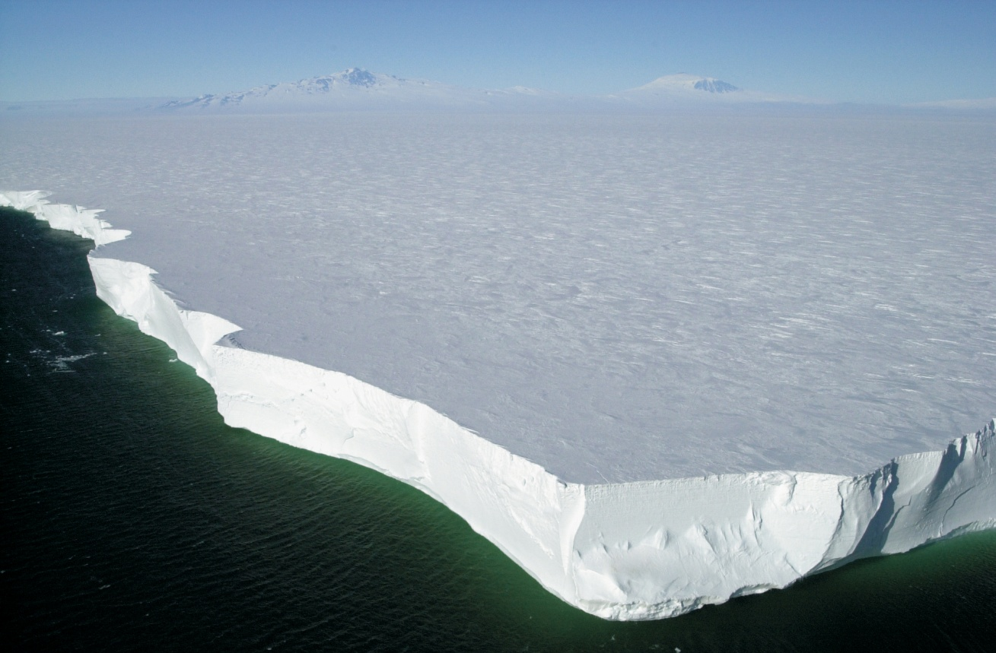
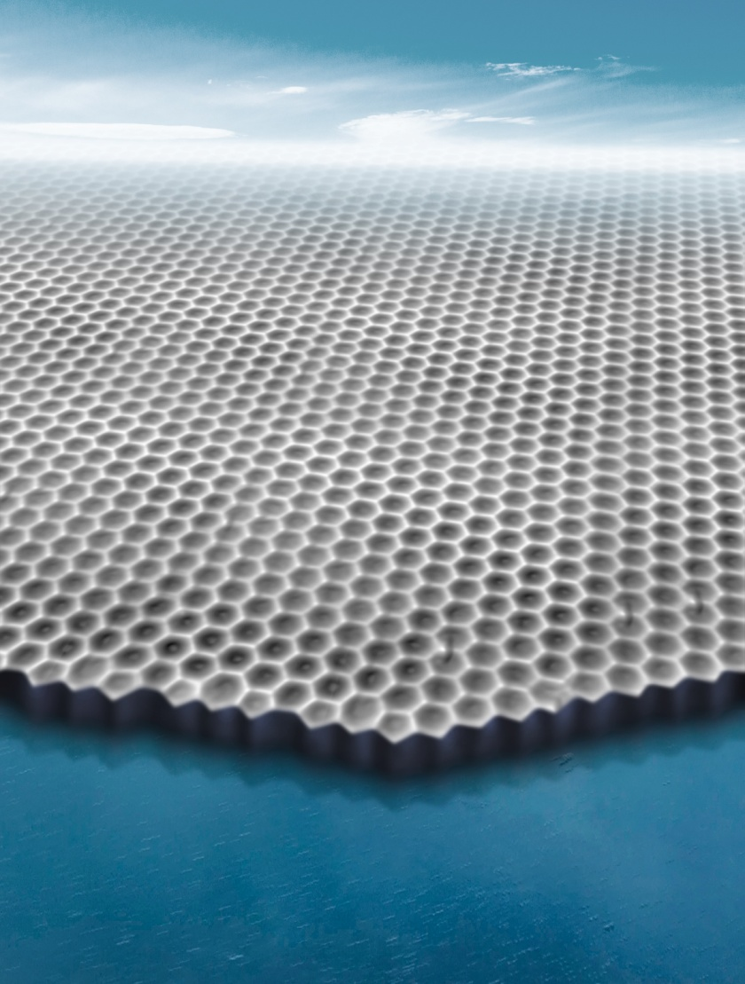
Genuine two-dimensional ice
Ice sheet on Ross Sea
18 crystalline phases (3D phases)
How about two-dimensional ice ?
Two-dimensional ice

Slide 47
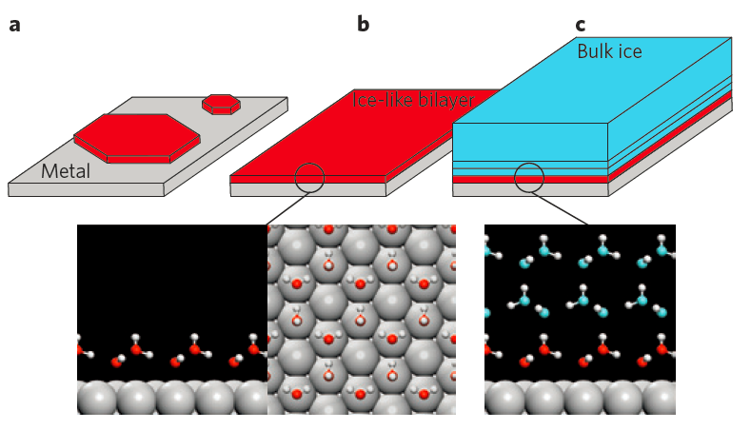
Two-dimensional ices on surface
The basal plane of ice I_{h}
The conventional bilayer-ice model for ice growth on solid surface
Nature Materials 11, 667 (2012)

Slide 48
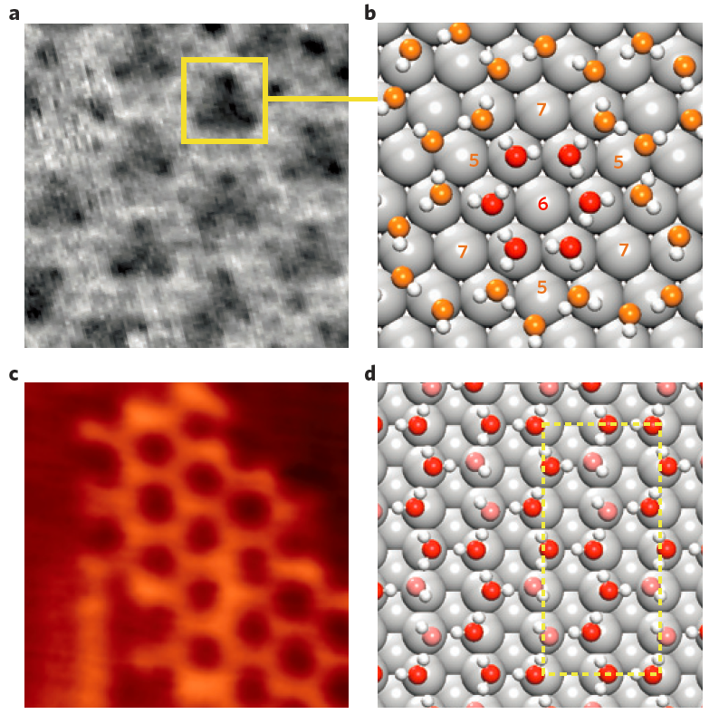
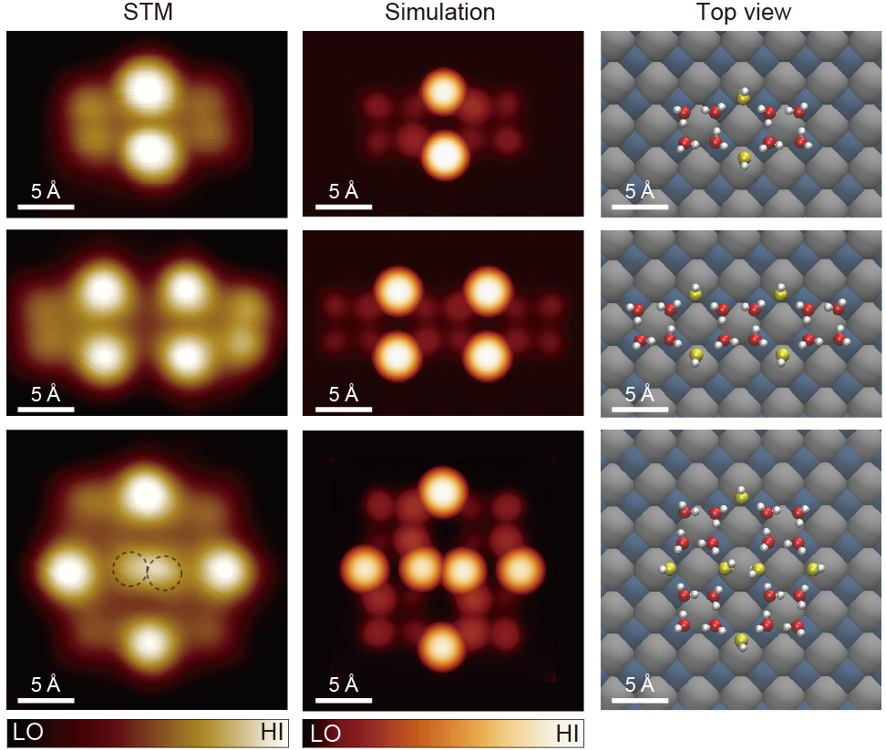
Two-dimensional ices on hydrophilic surface
Pt(111)
NaCl(001)
Cu(110)
Nature Materials 11, 667 (2012)
Nat. Commun. 5, 4056 (2014)
Those 2D ices rely on the lattice of substrate and cannot exist alone.

Slide 49
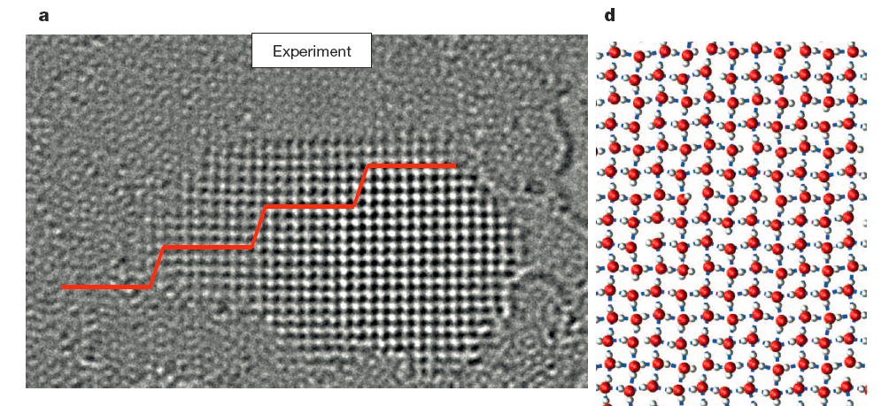
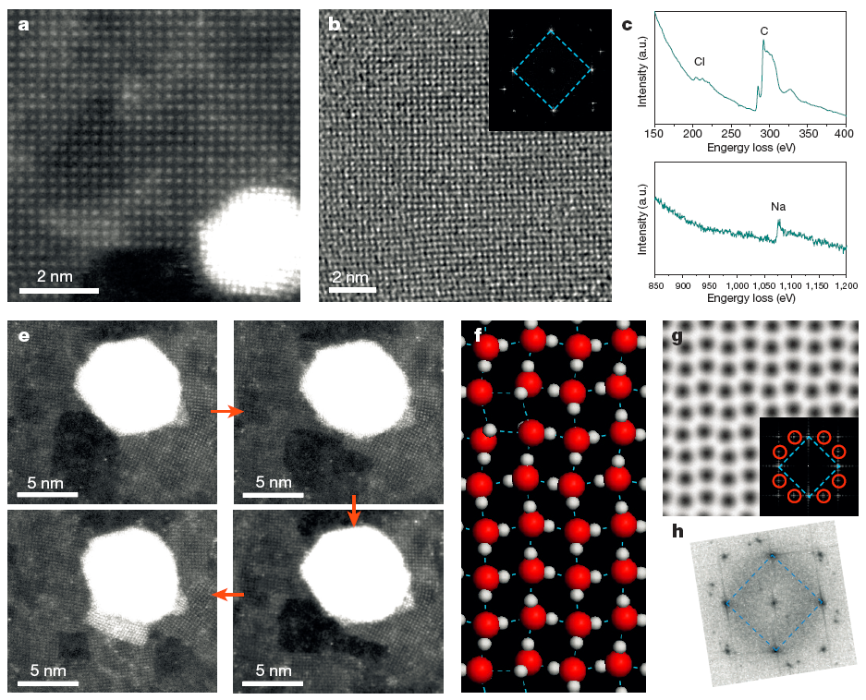

Square ice under hydrophobic confinement
Square ice between bilayer graphene
NaCl contaminant ?
Geim et al. Nature 519, 443 (2015)
Zhou et al. Nature 528, E1–E2 (2015)

Slide 50



Hexagonal Monolayer Ice on graphite
Self-assembly of closely packed water hexamers without edge sharing
Such a monolayer ice cannot grow to large size
Typically tens of nm
Phys. Rev. Lett. 121, 256001 (2018)

Slide 51

Structure of 2D ice on Au(111)
Interlocked flat bilayer-ice
The first genuine 2D ice confirmed both by theory and experiment !
2D ice I
Phys. Rev. Lett. 79, 5262 (1997)
Ma et al., Nature 577, 60 (2020)
Notes:
Comparison between experiment and DFT calculations reveals that these triangles correspond to the flat-lying water molecules in the ice structure, indicating a large area of proton-ordered water molecules inside the ice island. And the ice island is composed of interlocked hydrogen structure with all hydrogen atoms pointing inside the bilayer ice, which is visualized in molecular resolution for the first time.
Closer range images show clear ice structure bones, which gives us a way of studying the ice edge structure.

Slide 52

Ice I_{h}: hexagonal ice
Interlocked flat bilayer ice

Slide 53




Growth of the 2D ice
The 2D ice can perfectly cover the surface

Slide 54



Edge structure
STM
AFM
zigzag
armchair
zigzag
Ma et al., Nature 577, 60 (2020)
Notes:
As more AFM images are obtained, the pattern is clear. All the regular edges can be classified into 2 types. The one with pentagons and the ones without pentagons. And they happen to correspond to the armchair and zigzag directions.

Slide 55



Edge structure
5
7
5
5
7
5
armchair
6
6
6
6
6
6
6
6
6
zigzag
Ma et al., Nature 577, 60 (2020)
Notes:
As more AFM images are obtained, the pattern is clear. All the regular edges can be classified into 2 types. The one with pentagons and the ones without pentagons. And they happen to correspond to the armchair and zigzag directions.

Slide 56




Intermediate states at the edges
Ma et al., Nature 577, 60 (2020)

Slide 57

Ice growth at zigzag edge
Collective bridging mode
Ma et al., Nature 577, 60 (2020)
Notes:
Comparison between experiment and DFT calculations reveals that these triangles correspond to the flat-lying water molecules in the ice structure, indicating a large area of proton-ordered water molecules inside the ice island. And the ice island is composed of interlocked hydrogen structure with all hydrogen atoms pointing inside the bilayer ice, which is visualized in molecular resolution for the first time.
Closer range images show clear ice structure bones, which gives us a way of studying the ice edge structure.

Slide 58

Ice growth at armchair edge
Local seeding mode
Ma et al., Nature 577, 60 (2020)
Notes:
Comparison between experiment and DFT calculations reveals that these triangles correspond to the flat-lying water molecules in the ice structure, indicating a large area of proton-ordered water molecules inside the ice island. And the ice island is composed of interlocked hydrogen structure with all hydrogen atoms pointing inside the bilayer ice, which is visualized in molecular resolution for the first time.
Closer range images show clear ice structure bones, which gives us a way of studying the ice edge structure.

Slide 59

MD simulation of ice growth
ZZ
AC
The growth behavior shows negligible dependence on the water spacing and the commensurability with the substrate.
Ma et al., Nature 577, 60 (2020)

Slide 60

2D vs 3D ice growth
The 2D ice growth has strong implication for 3D ice growth
Proc. Natl. Acad. Sci. U. S. A. 114, 11285-11290 (2017)

Slide 61
What is the next:
Hydrated ions under confinement
Amorphous and glassy ice
Real liquid/solid interfaces

Slide 62
Hydrated ions under confinement
Spontaneous 1D polymerization of hydrated alkali ions on surface
The reason for high throughout rate and selectivity of biological ion channel？
Tian et al., in preparation

Slide 63


_{Amorphous and glassy ice}
The most common structure for H₂O in the universe at large
Low-density amorphous ice (LDA) and how-density amorphous ice (HDA)
Similarity with the structure of supercooled water
You et al., in preparation

Slide 64
Creating liquid/solid interface under UHV
Balajka et al., Science 361, 786–789 (2018)

Slide 65
Cu/formate solution interface
Peng et al., Nature 586, 390 (2020)
The formate forms c(6×2) superstructure on the Cu(110) surface

Slide 66

In-situ AFM under liquid environment
3D atomic force imaging at water/mica interface
Fukuma et al., Nanoscale 5, 2678 (2013)

Slide 67


Perspective on new SPM techniques
SPM + Spectroscopy :
Nanospectroscopic chemical imaging
Couple the MW, THz, IR, Vis, X-ray into the SPM tip junction
Notes:
水的界面，尤其是电化学水界面的物理与化学过程复杂，受界面处的原子分子结构、电子结构、形貌、局域电解质环境等等诸多因素影响。因此，单一实验技术难以清楚地回答界面处的物理过程和化学过程。因此，针对电化学界面科学的一些关键科学问题，开发综合分析系统，结合X光电子谱、和频光谱、扫描探针等技术的优势，发展和改进相应实验方法，会有利于攻关一些有影响力的水界面科学的难题。

Slide 68














金刚石氮-空位色心（NV center）
Diamond
Optical detected magnetic resonance (ODMR)
~10 ns
~10 ns
Fluorescence
2$\text{γ}\text{B}$
2.87 GHz
Frequency
~250 ns
$${\text{m}}_{\text{s}}\text{=}\text{±}\text{1}$$
2$\text{γ}\text{B}$
2.87 GHz
Atomic-size defect
$${\text{m}}_{\text{s}}\text{=0}$$
Spin-1 system
室温大气下相干时间可达毫秒量级，自旋态由光来读取

Slide 69
NV center的电荷态调控
NV-
NV+
利用STM/AFM针尖的局域电场对单个NV center实现电荷态和自旋态的稳定调控
NV-
Bian, YJ*, et al., submitted

Slide 70




SPM combined with NV-center technology
Home-made NV-SPM
Scanning Quantum Sensing based on NV-center
Highlights:
High sensitivity
Harsh environment
Non-invasive
nm resolution
Doherty et al., Nat. Electron. (2018)
Yang et al. Phys. Rev. B (2018)
Magnetic field:
NMR of protons
Electric field:
Dielectric response
Bian et al., arXiv:2011.04473

Slide 71
Other SPMs
By integrating micro-sensors on the tip or coupling the electromagnetic waves with the tip-sample junctions, a big family of SPMs have been developed since the invention of STM and AFM. Various signals besides current and force, such as magnetic/electric field, photon, strain, temperature, dielectric and physiological responses, can be mapped in real space.
Ballistic electron emission microscopy (BEEM)
Chemical force microscopy (CFM)
Conductive atomic force microscopy (C-AFM)
Electrochemical scanning tunneling microscopy (ECSTM)
Electrostatic force microscopy (EFM)
Fluidic force microscopy (FluidFM)
Force modulation microscopy (FMM)
Kelvin probe force microscopy (KPFM)
Magnetic force microscopy (MFM)
Magnetic resonance force microscope (MRFM)
Near-field scanning optical microscopy (NSOM)
Photon scanning tunneling microscopy (PSTM)
Synchrotron x-ray scanning tunneling microscopy (SXSTM)
Scanning diamond magnetometry
Photothermal microscopy (PTMS)
Piezoresponse force microscopy (PFM)
Scanning capacitance microscopy (SCM)
Scanning electrochemical microscopy (SECM)
Scanning gate microscopy (SGM)
Scanning Hall probe microscopy (SHGM)
Scanning ion-conductance microscopy (SICM)
Scanning SQUID microscopy
Scanning spreading resistance microscopy (SSRM)
Scanning thermal microscopy (SThM)
Scanning tunneling potentiometry (STP)
Scanning voltage microscopy (SVM)
Scanning single-electron transistor microscopy (SSET)
Spin-polarized scanning tunneling microscopy (SPSM)
More on the way…

Slide 72
Perspectives
Limitations:
Tip disturbance
Buried interface
UHV conditions
Future trends:
Coherent detection and control
Quantum sensing
Extreme conditions
3D imaging
Machine learning

Slide 73

A recent mini-review on SPM
该综述详细介绍了扫描探针显微镜的基本原理和设备构造，展示了如何实现高分辨成像、谱学以及原子分子操纵技术，总结了扫描探针显微术在物理学、化学、材料科学和生物学方向的最新应用，并梳理了该领域现存的技术挑战和未来的发展趋势。

Slide 74
下一次课
第九课 表面能量分辨技术

